Slide 1
ANDROID PROJECT: CAPITOLE
Frédéric Montet & Dan Luong Ba
Professors : Ninoslav Marina & Pascal Bruegger

Slide 2
Objectives
Create an Android application that builds a personal ​movie database. ​
Allow different categories and ratings. ​
Connected to the existing movie databases. ​
Suggest movies according to user preferences.​

Slide 3
Multi-layers architecture (1/2)
Model and API data retrieval
Objects controllers
View displays

Slide 4
Multi-layers architecture (2/2)
CAPITOLE
DOMAIN
PRESENTATION
mapper
model
net
activity
adapter
fragment

Slide 5
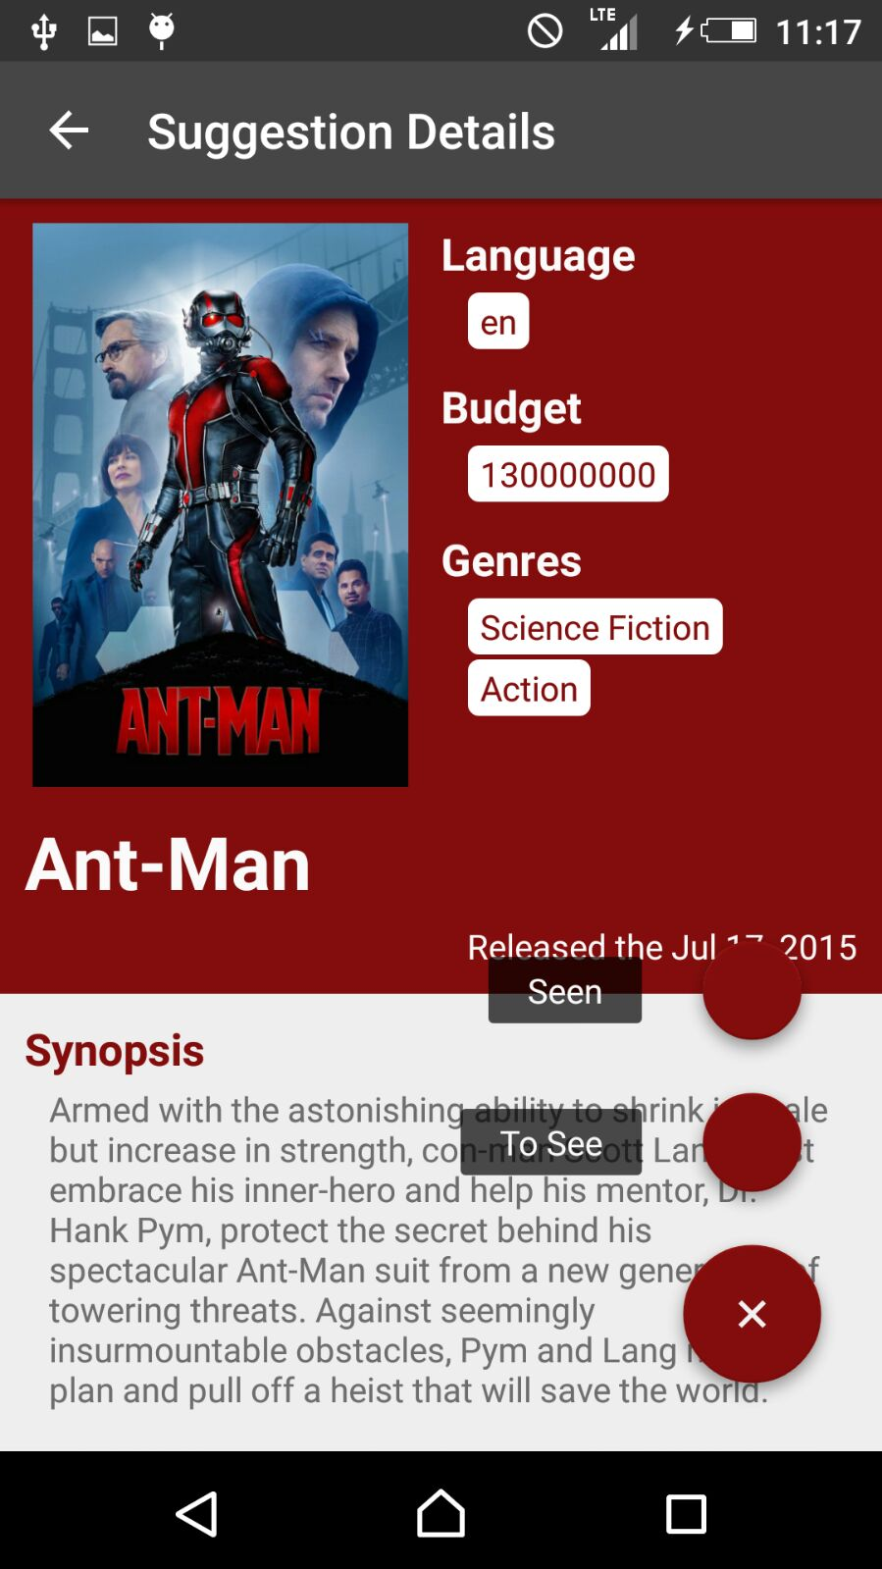
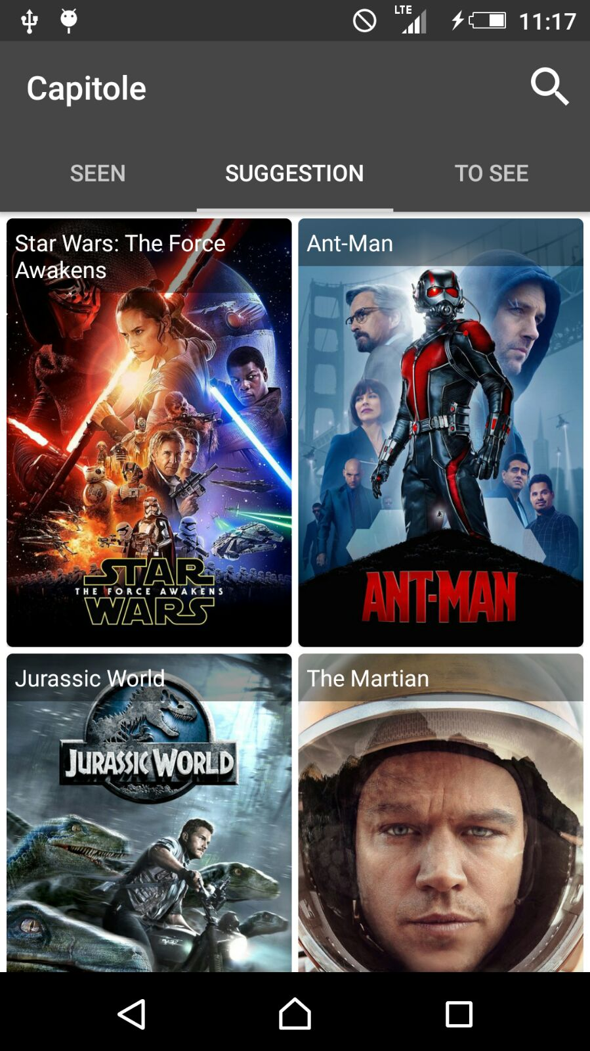
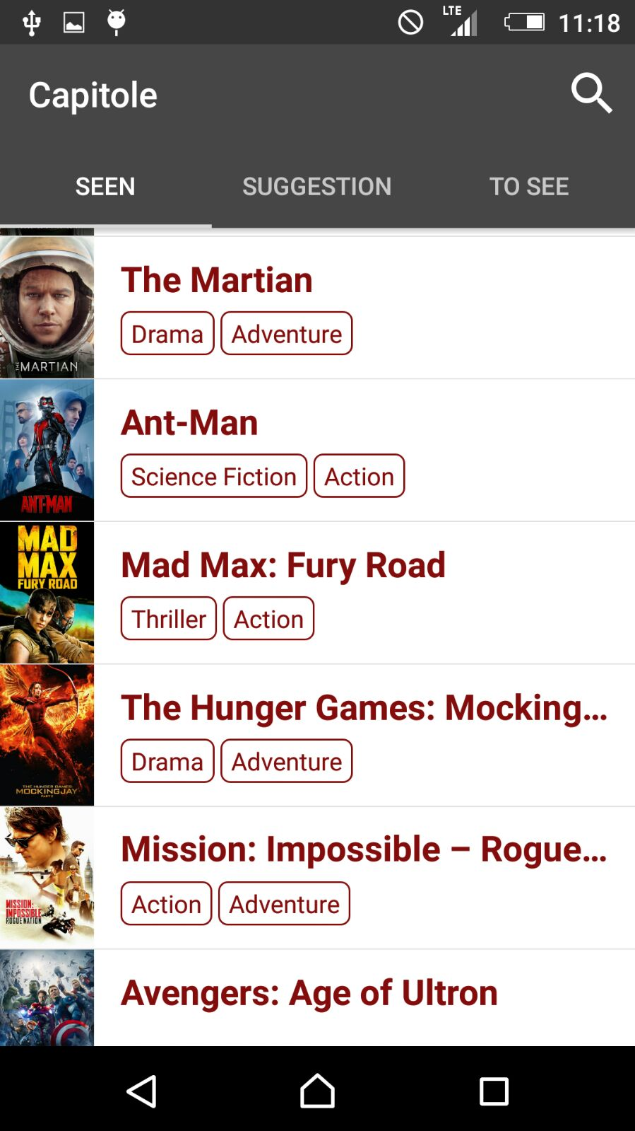

Slide 6

LET’S START THE PRESENTATION

Slide 7
THANK YOU FOR YOUR ATTENTION

